Slide 1
Correlation and Regression
GES 408/608

Slide 2
Correlation
When two numerical variables are associated, we say that they are correlated.
Correlation reflects the amount of “scatter” in a scatter plot of two variables.
Does not fit a line to the data.
Does not measure how steeply one variable changes when the other is varied.
  That is the job of linear regression!
Notes:
ASK: Does correlation mean causation? NO! give example on the next slide.

Slide 3

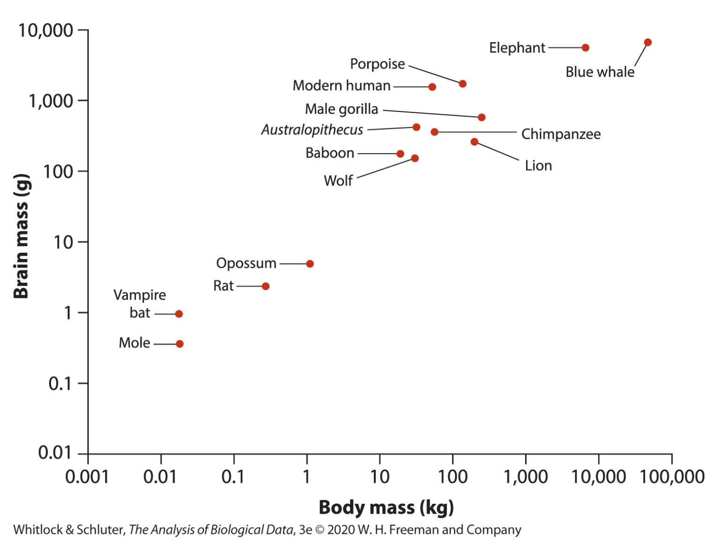
Example:
Brain size and body size are positively correlated across mammal species.
Notes:
Here’s an example of what this could look like.
As the body of a mammal gets bigger, their brain also gets bigger.

Slide 4
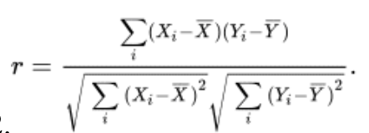
Correlation Coefficient
The correlation coefficient is a quantity that describes the strength and direction of an association between two numerical variables measured on a sample of subjects or units.

Slide 5
Correlation Coefficient
The term in the numerator of the formula is called the sum of products, and it measures how deviations in X and Y vary together.
A deviation is the difference between an observation and its mean
E.g., if an observation i is above the mean for both X and Y (upper right corner of the figure), then its deviations are both positive and so the product of its deviations is a positive number.
The sum of products adds all the products of deviations.

Slide 6
Correlation Coefficient
The denominator includes the sums of squares for X and for Y (under square- root signs).
The correlation coefficient has no units, which means it is readily interpretable whatever the variables (provided they are numerical).
Notes:
• Not affected by linear
transformations of y or x
• Does not distinguish between
dependent and independent
variable (e.g. height and weight)
• Population Parameter – rho (Greek lowercase p)
This does not provide you any information about the slope, only the degree to which points are linear

Slide 7
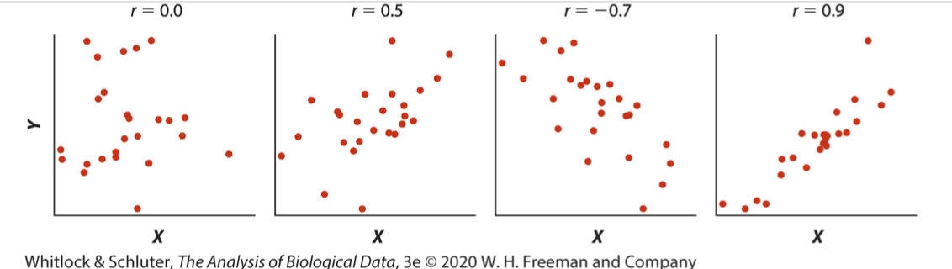
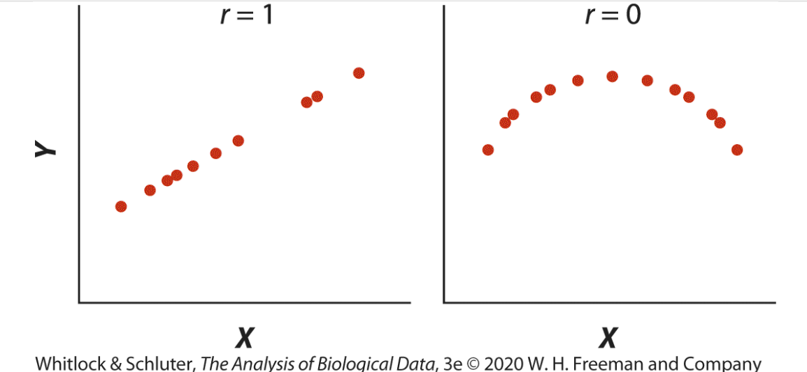
Notes:
A negative correlation means that one variable decreases as the other increases, whereas a positive correlation means that both variables increase and decrease together.
The strongest correlations (i.e., r=1.0 or r=−1.0 ) occur when all points lie along a straight line that is not horizontal, which is why we refer to the correlation as linear.
ASK: are these two variables associated? Yes. Do they align with the idea of linear correlation? No.
Two variables might be strongly associated yet have no correlation (i.e., r=0 ) if the relationship between them is nonlinear

Slide 8

Standard Error of the Correlation Coefficient
The data are merely a sample taken to estimate the correlation between the same two variables in a population.
The standard error of r —that is, the standard deviation of its sampling distribution—is one way to assess how close our estimate is likely to be to the population parameter ρ.
Notes:
Point of this slide: there is standard error. You can also calculate a CI for the correlation coefficient. However, my exec. Decision is that that is not super important compared to other things so lets move on

Slide 9

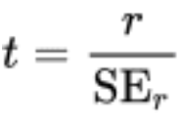
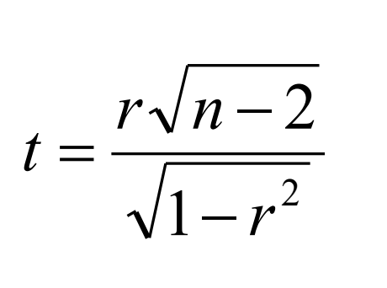
Correlation and Hypothesis Testing
The most common use of hypothesis testing in correlation analysis is to test the null hypothesis that the population correlation ρ is exactly zero
Calculate the correlation coefficient and the standard error, and get the test statistic
The sampling distribution of the test statistic is a Student’s t-distribution with n-2 degrees of freedom
Is your calculated test statistic greater or less than the critical value? Greater than; p is less than listed value, reject null, less than; p is more than listed value, cannot reject null
Notes:
You know the drill here! ☺
Formulas are the same
Notice: with higher n you can get a higher t – if you have a humongous sample size, even if the correlation is weak it might still register here (SPURIOUS correlation)

Slide 10
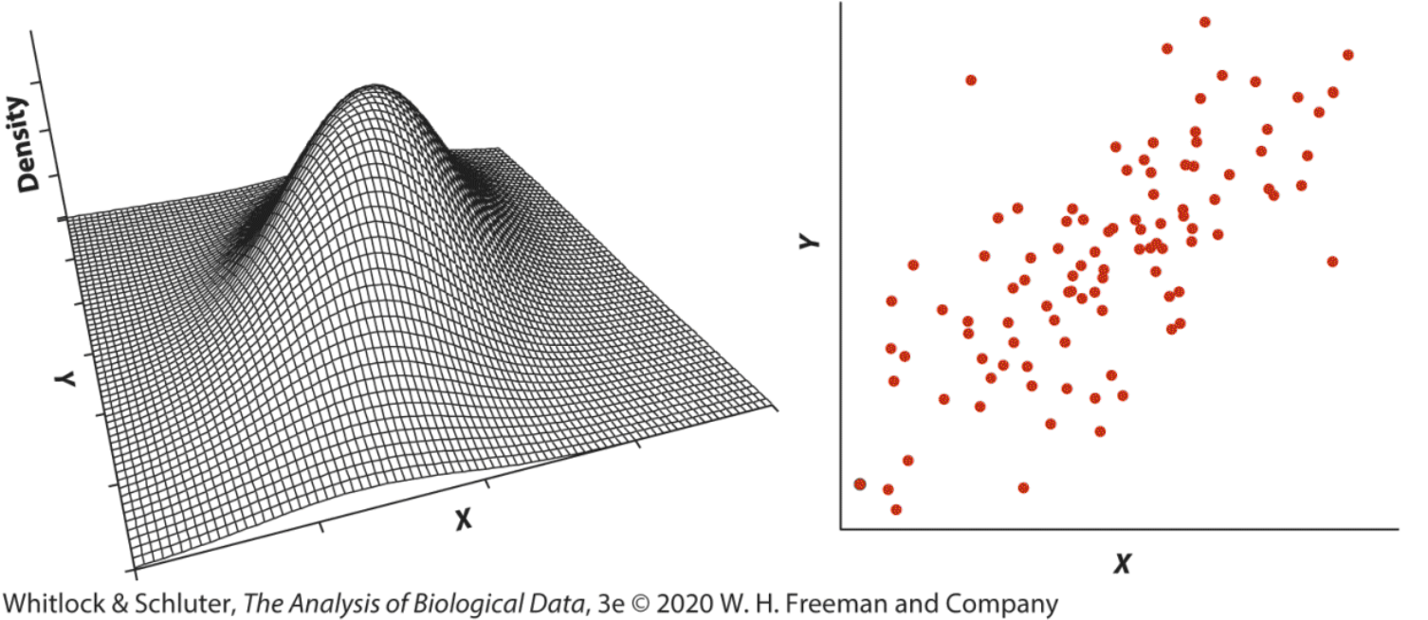
Correlation - Assumptions
Notes:
Bivariate normal distribution
- The relationship between X and Y is linear.
- The cloud of points in a scatter plot of X and Y has a circular or elliptical shape.
- The frequency distributions of X and Y separately are normal.

Slide 11
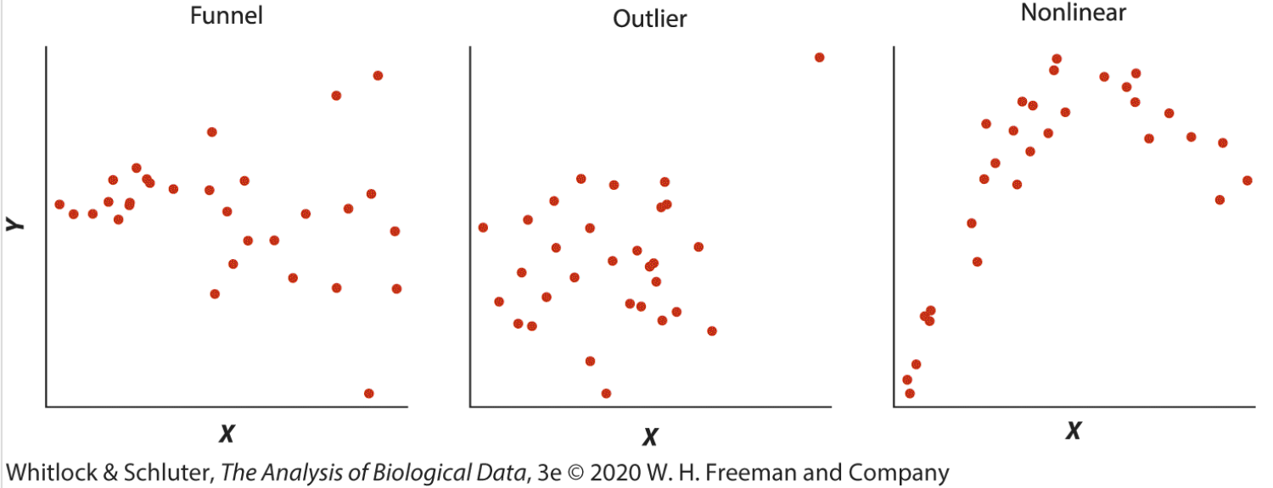

Departures from Bivariate Normality
Notes:
These are the most frequent types of departures from bivariate normality. (These are also the types of departures that most seriously affect correlation analysis!)
You can try data transformations or use a nonparametric method instead, such as Spearman’s rank correlation.
Spearman’s rank correlation uses the ranks of both the X and Y variables to calculate a measure of correlation.
assumes that observations are a random sample from the population.
assumes that the relationship between the two numerical variables is monotonic. That is, as one variable increases, the other variable either (1) increases or does not change; or (2) decreases or does not change.
relationship between the ranks of the two numerical variables is linear.

Slide 12
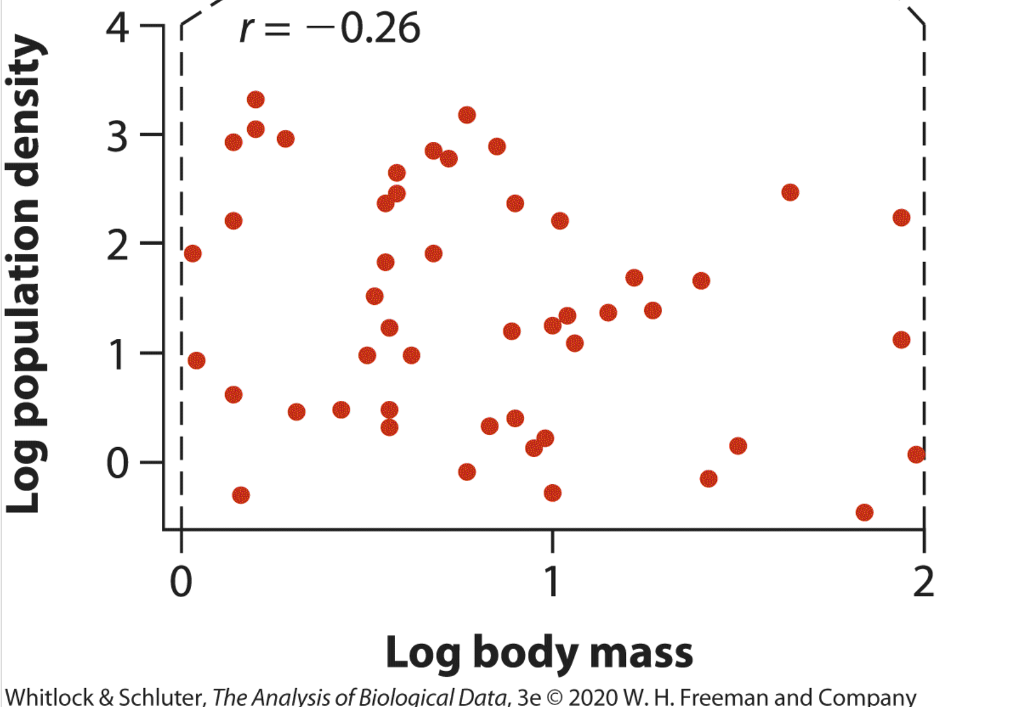
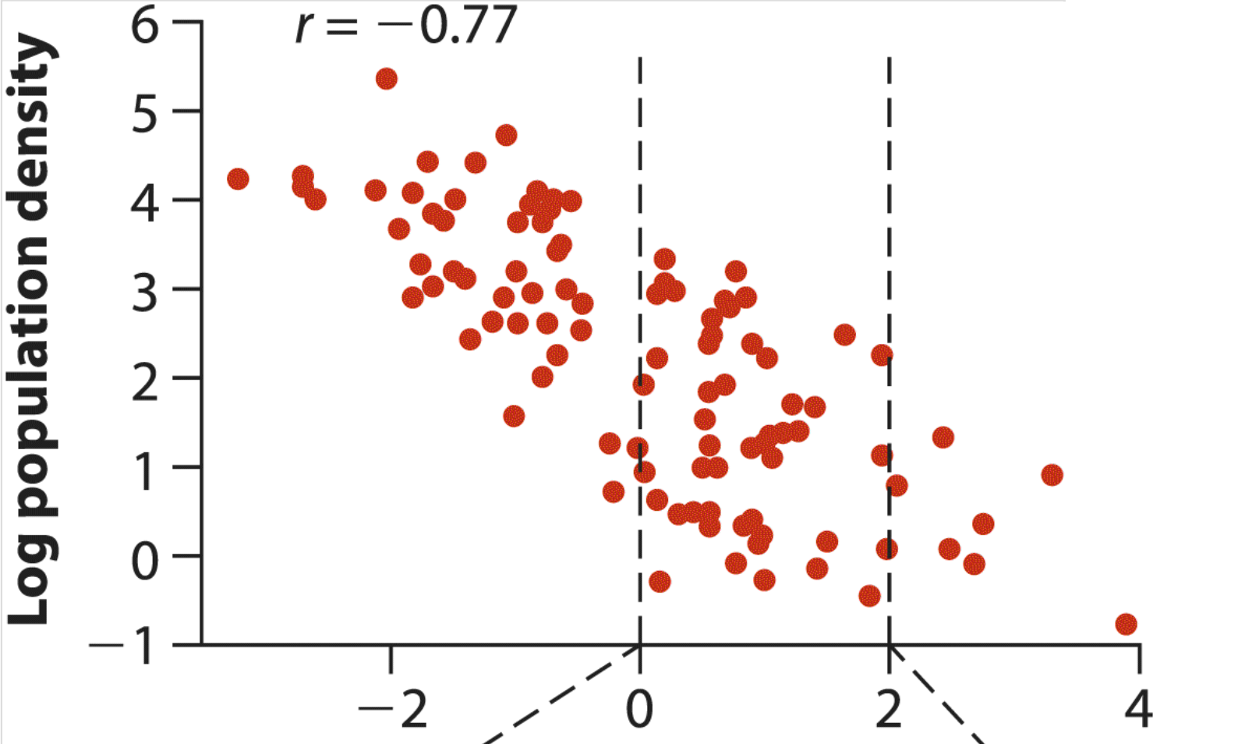
Correlation - Range
The correlation between two variables X and Y depends on the range of values included.
The correlation coefficient between the same two variables is not comparable between separate studies unless they include a comparable range of values.
Notes:
ASK: thumbs up/thumbs down: on the top, would you say these variables are correlated strongly? What about the bottom?
On top, correlation is weaker, because the amount of scatter relative to total variation is increased. Range is different!!
Also think about: Measurement error - the difference between the true value of a variable for an individual and its measured value.
Weakens observed correlation between variables
With measurement error, r will tend to underestimate the magnitude of ρ (it will tend to be closer to zero on average than the true correlation), a bias called attenuation
In general, measurement error can be reduced by taking precise measurements. If this is not possible, then it is best to measure each individual multiple times and use the average measurement in subsequent analysis.

Slide 13
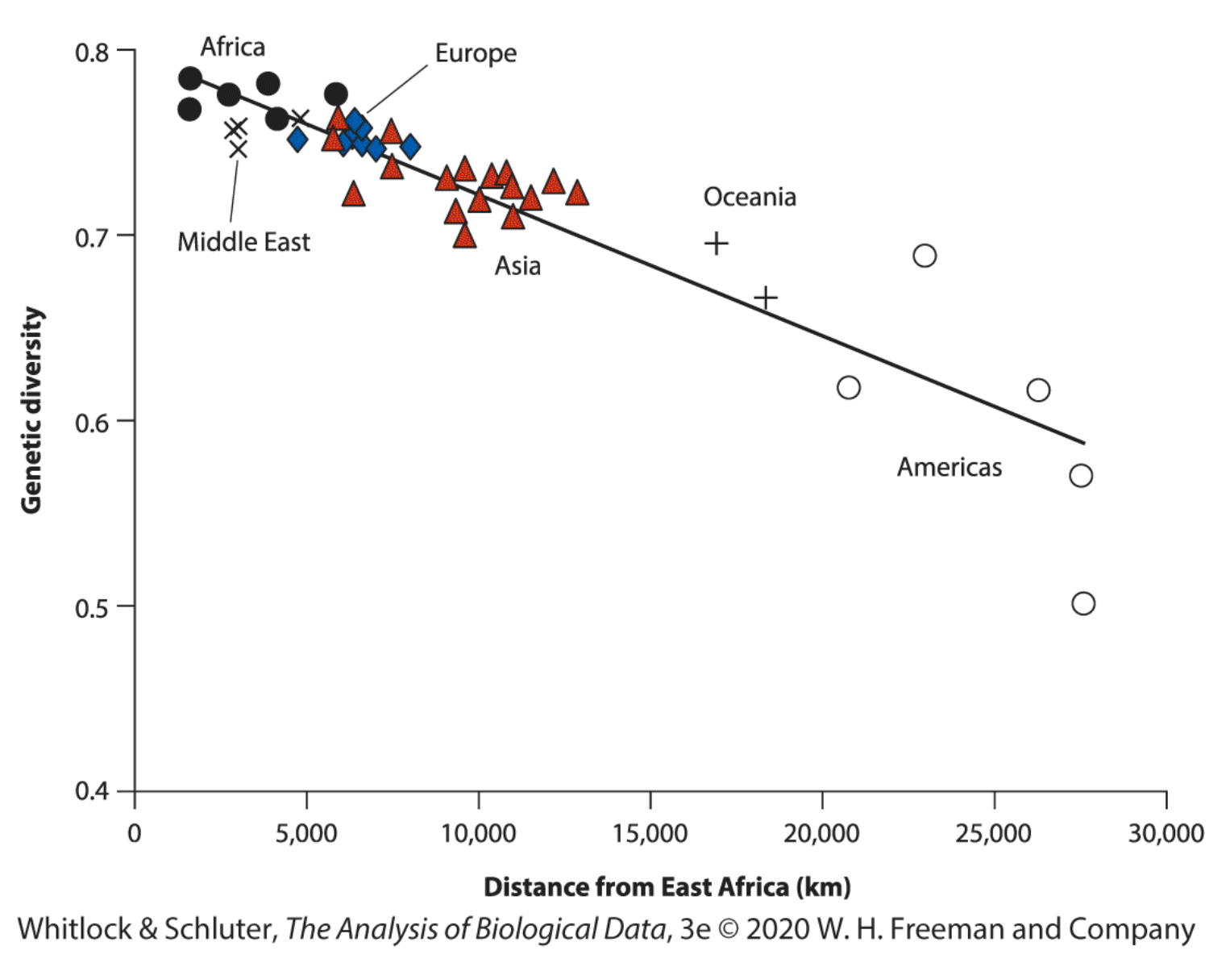
Regression
The method used to predict values of one numerical variable from values of another.
The line fitted to the data is the regression line.
Notes:
Example on the slide: genetic diversity in a local contemporary human population is predicted by its dispersal distance from East Africa by fitting a straight line to the data points.
Modern humans emerged from Africa around 60,000 years ago, and our ancestors lost some genetic variation at each step as they spread to new lands.

Slide 14
Regression
Line can be used to predict the genetic diversity of a local human population even for a locale not included in this study, based on its dispersal distance from East Africa.
The slope or steepness of the regression line indicates the rate of change of genetic diversity with distance.
Notes:
Regression fits a line through the data to predict one variable from another and to measure how steeply one variable changes with changes in the other. Correlation does none of these things. It measures strength of association between two variables, reflecting the amount of scatter in the data.

Slide 15


Regression: Types of Experiments
1. Individuals are randomly sampled from a population. Two variables are measured on the sample, and one of them (deemed the explanatory variable) is used to predict the other (response) variable.
2. The researcher fixes or chooses values of the explanatory variable, which represent treatments or doses. The response variable is then measured on one or more individuals assigned to each treatment.
Notes:
Only the first design matches the assumptions of correlation, but both scenarios are suitable for regression.
ASK: hold up your hand – if I was measuring like “amount plant grew with amount of fertilizer given” which would that be? And then if I had my Chesapeake bay dolphins and I was taking them and measuring like ”body length and lung capacity” which would that be?

Slide 16
Linear Regression
The most common type of regression.
Draws a straight line through the data to predict the response variable (Y, shown on the vertical axis) from the explanatory variable (X, shown on the horizontal axis).
  How do we find the best straight line? It’s the line that has the smallest possible deviations in Y between the data points and the regression line.
The least squares regression line is the line for which the sum of all the squared deviations in Y is smallest.
Notes:
One important assumption of the linear regression method is that the relationship between the two variables really is linear
The response variables are a function of the explanatory variables

Slide 17
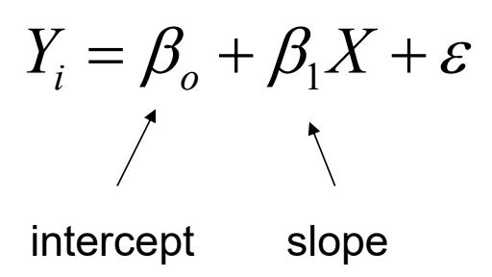
Linear Regression Model
You have seen this before!
Notes:
The symbol Y is the response variable (displayed on the vertical axis in a scatter plot), and X is the explanatory variable
The coefficient Bo is the Y-intercept , or just the intercept. Mathematically, Bo is the value of Y when X is zero (hence, it is the Y-value where the regression line “intercepts” the y-axis ). Its units are the same as the units of Y.
The coefficient B1 is the slope of the regression line. It measures how much Y changes per unit change in X. Its units are the ratio of the units of Y and X. If B1 is positive, then larger values of X predict larger values of Y. If B1 is negative, then larger values of X predict smaller values of Y.
The e is error term. Will explain how to calculate that. It is assumed to be normal with a mean of 0 and a variance of (lowercase) sigma squared
DO Y=MX+B on the board!!!

Slide 18
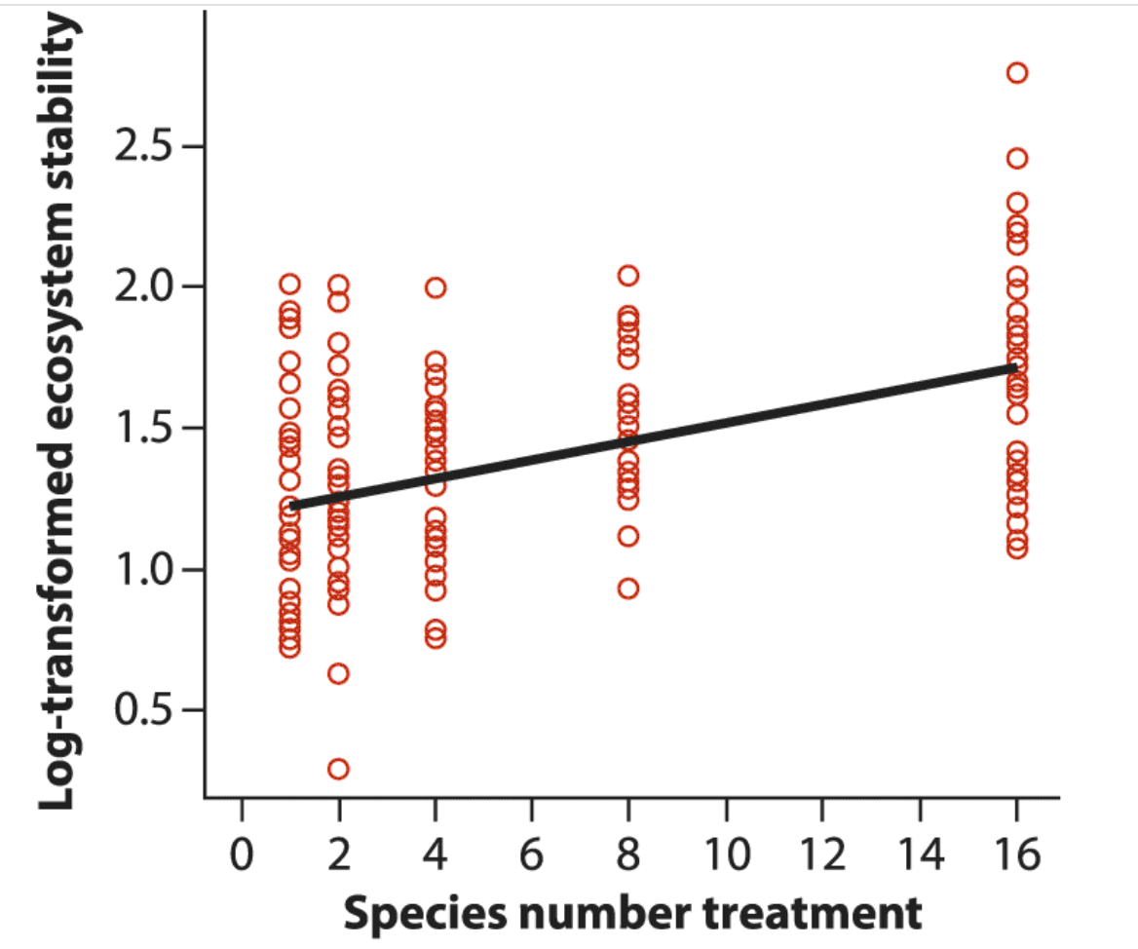
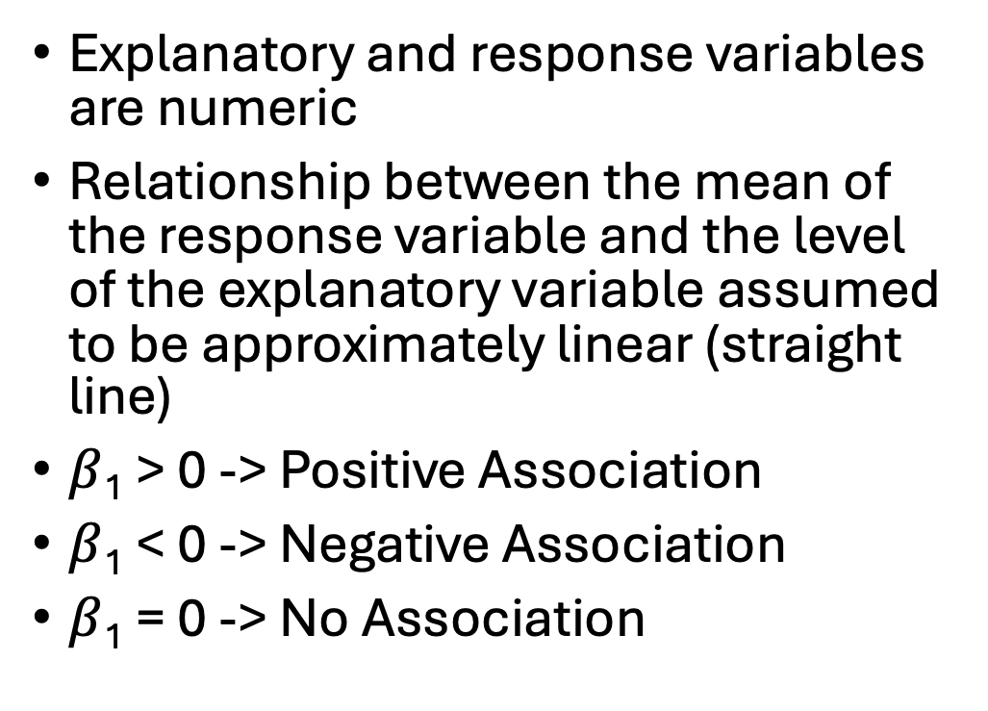
Linear Regression Model
Explanatory and response variables are numeric
Relationship between the mean of the response variable and the level of the explanatory variable assumed to be approximately linear (straight line)
$β$₁ > 0 -> Positive Association
$β$₁ < 0 -> Negative Association
$β$₁ = 0 -> No Association
Notes:
We will get there but b1 being zero is your null hypothesis
Also just wanted to have this graph on the board here to show you that just because something is numeric doesn’t mean it has to be continuous – this is useful when you’re assigning treatments (giving 1 vs. 2 vs. 3 grams of fertilizer to a plant)

Slide 19
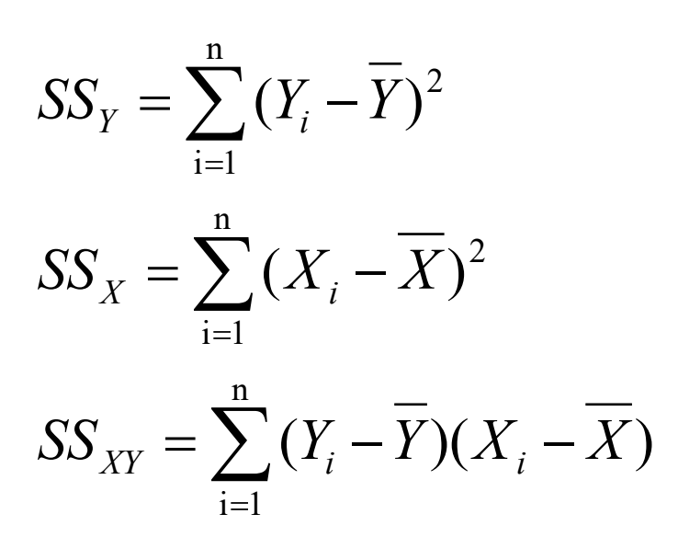
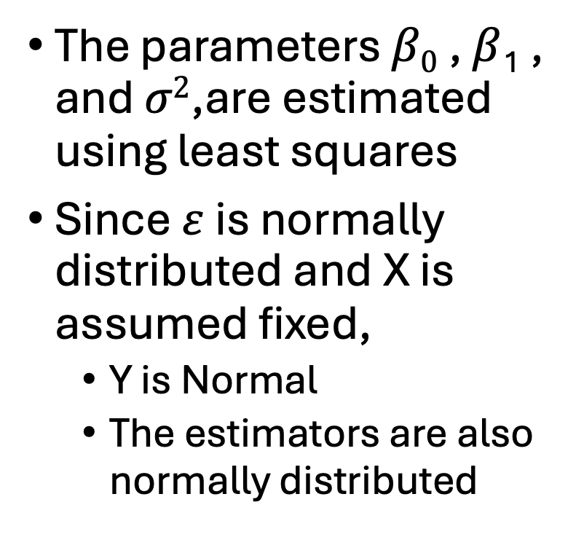
Parameter Estimation
The parameters $β0$ , $β$₁ , and $σ2$,are estimated using least squares
Since $ε$ is normally distributed and X is assumed fixed,
  Y is Normal
  The estimators are also normally distributed
Notes:
Estimators meaning not parameters (the things you measure yourself and calculate yourself
The formulas on the right are the first thing you need to do for calculations (the last one cross product is for every pair of data points)

Slide 20
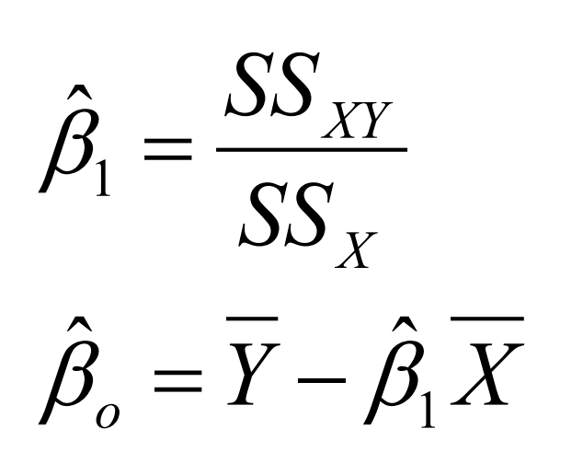
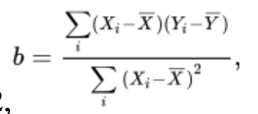
Parameter Estimation
Notes:
These little hats mean estimators
Slope is cross product standardized by sum of squares x
Intercept you plug in the means!
Once we have the slope b , getting the intercept is relatively straightforward, because the least squares regression line always goes through the point (X ̄, Y ̄)

Slide 21
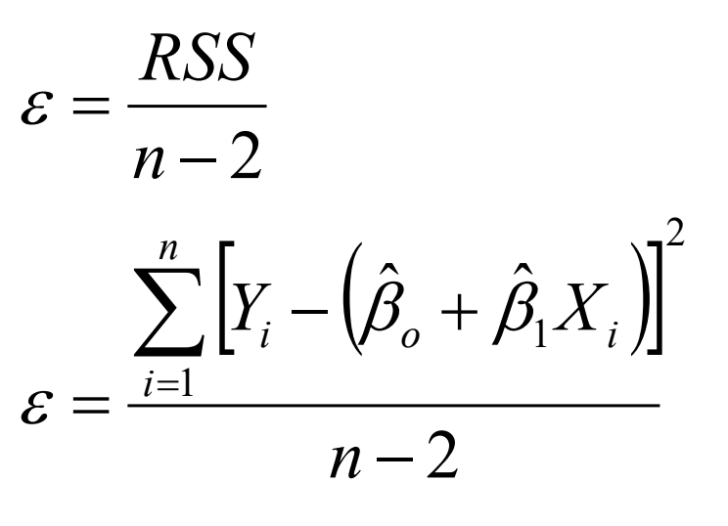
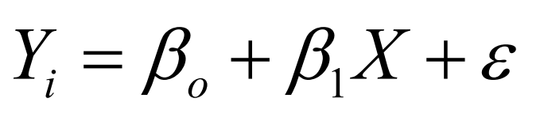
Parameter Estimation: Error
Last term to estimate is the error term:

Slide 22
Regression Line
Regression assumes that there is a population of possible Y-values for every possible value of X. The mean Y-value for each value of X lies on the true regression line.
Now that we have the regression line, we can use it to determine points on the line that correspond to specified values of X
  Symbolize predictions as Y-hat
  The predicted value of Y for a given value of X estimates the mean of Y for the whole population of individuals having that value of X

Slide 23
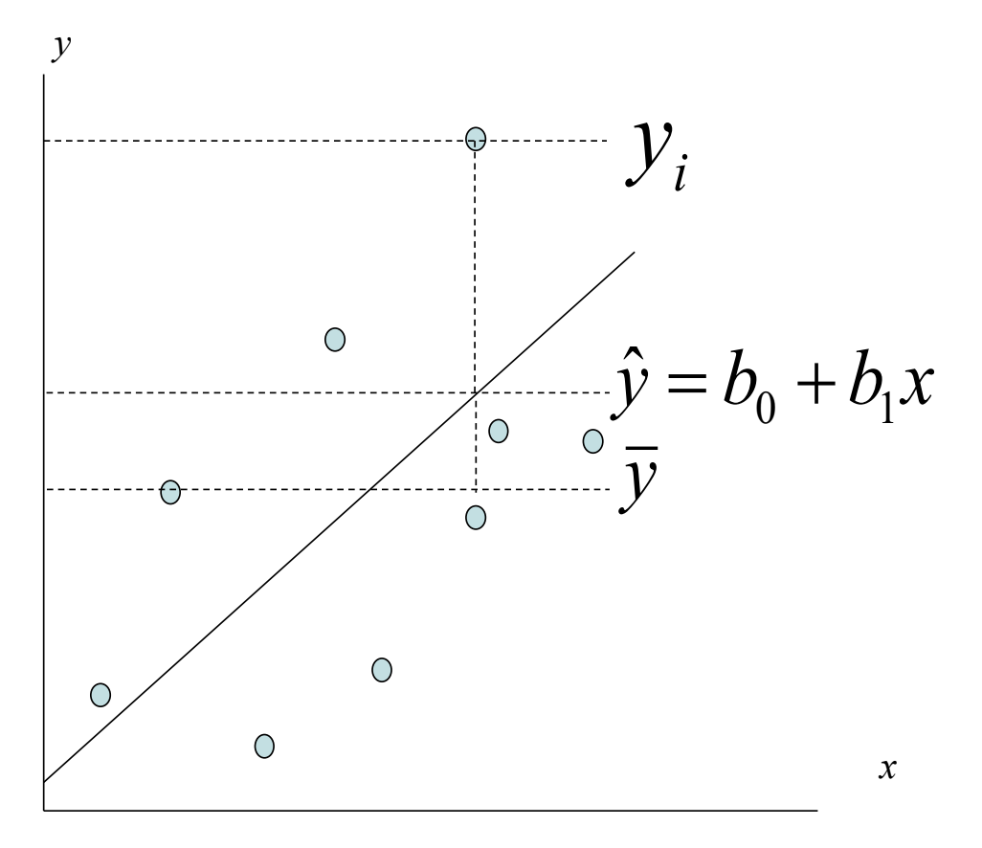

Notes:
Let’s say we are looking at lions in the Serengeti. Male lions’ noses turn black over the course of their life. So we can use the proportion of their nose that’s black as the explanatory variable and their age as the response variable.
We take a bunch of data points finding a bunch of male lions and photographing them to figure out the proportion of their nose that’s black, and working with park rangers to figure out how old they are.
The mean age of all of the lion individuals we sampled is y-bar.
An individual data point is yi.
Y-hat is the predicted y based off of a specific value of x. so if his nose was 60% black the predicted age would be like 5 years or something like that.

Slide 24
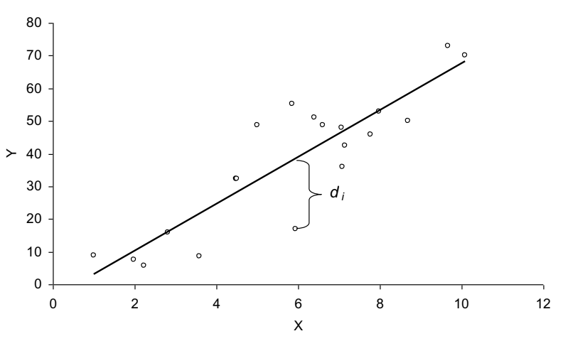
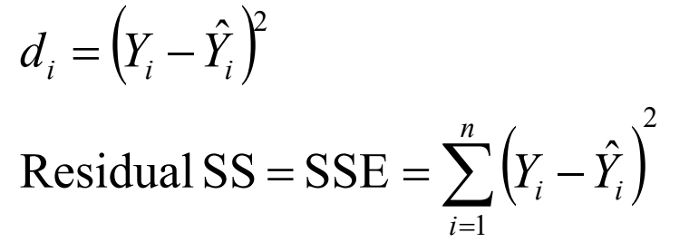
Parameter Estimation: Residuals
Residual: squared difference between an observed value and its predicted value in the regression
Residual Sum of Squares (SS) is the sum of all of the residuals
Best regression line is the one that minimizes this value
Notes:
E here stands for error
If all the points are on the line you have no error, if the points are farther from the line there’s more error
Remember: y-hat is your predictions
Explain using graph
Make a residual plot on the board – remember if you plot the residuals, it’s best if they are randomly scattered about pretty evenly above/below the line (indicates good fit to linear model)

Slide 25
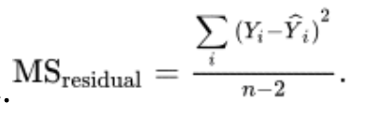
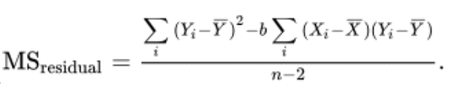
Residuals
Residuals measure the scatter of points above and below the least squares regression line.
evaluate the fit of the line to the data
The variance of the residuals, symbolized as MS_{residual} , quantifies the spread of the scatter of points above and below the line. In regression jargon, this variance is called the “residual mean square”:

Slide 26
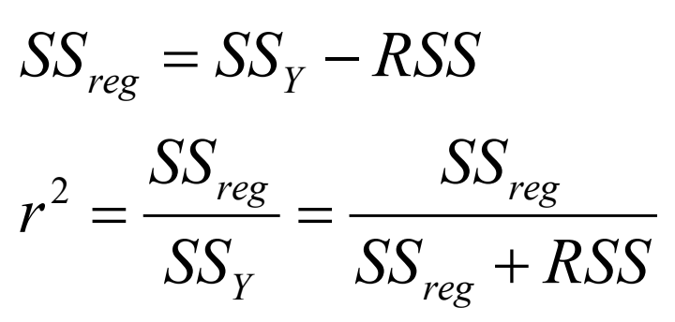
How much variation is explained by the linear model?
After calculating model error, we should be able to quantify how much variation is explained...
Coefficient of Determination
Or, r²
The fraction of total variation explained by regression.
(Square-root of r² is also Pearson’s correlation coefficient)
Notes:
First line: the difference is what’s explained by regression (ss y minus residual ss)

Slide 27
r² Value
Measures the fraction of variation in Y that is “explained” by X in the estimated linear regression.
If r² is close to one (i.e., its maximum possible value), then X predicts most of the variation in the values of Y. In this case, the Y- observations will be clustered tightly around the regression line with little scatter.
If r² is close to zero (i.e., its minimum value), then X does not predict much of the variation in Y , and the data points will be widely scattered above and below the regression line.
Notes:
If my linear regression model of lion noses had an r2 of 0.85, would you say the proportion of their nose that’s black “explains” their age well?
What if the r2 was 0.19? Would their nose predict their age well?

Slide 28
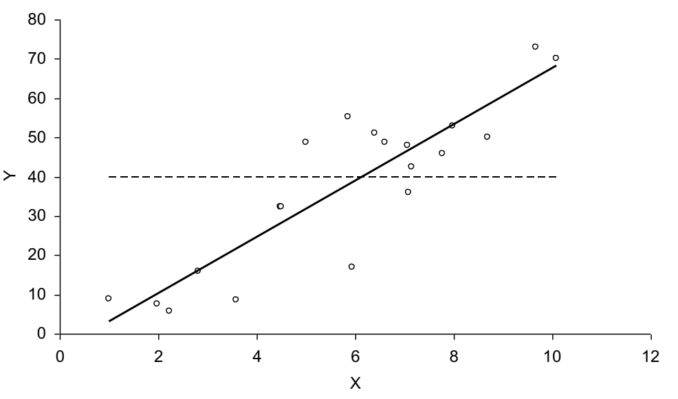
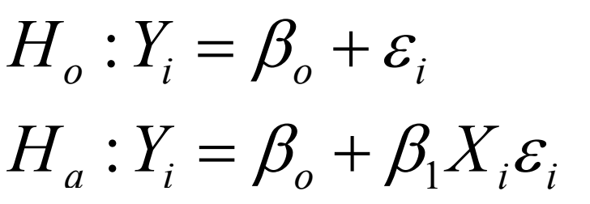
Hypothesis Testing With Regression
Null – no pattern
Alternative – slope is positive/negative
Notes:
Alternative is that some kind of relationship exists!
H0 : The slope of the regression of proportion of nose black on male lion age is zero (β=0).
HA : The slope of the regression of “” is not zero (β≠0).

Slide 29
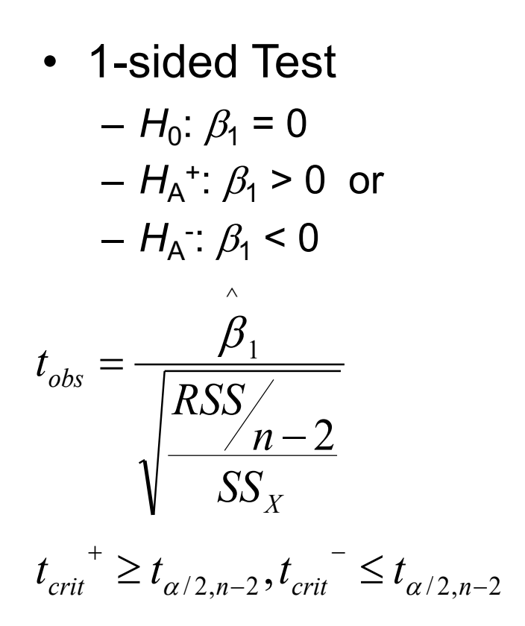

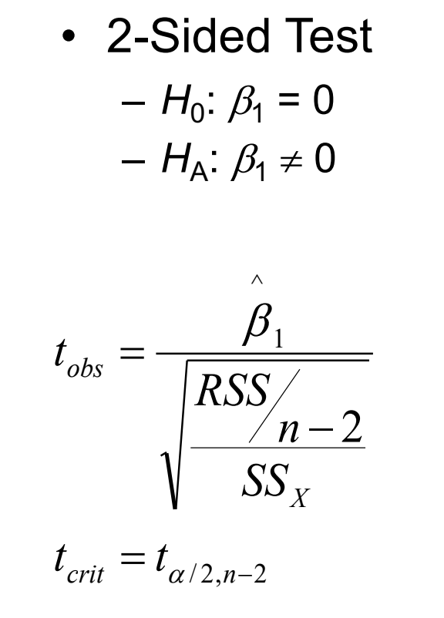
Hypothesis Test
This is the same formula for your observed t-value
Notes:
Essentially is the slope minus the null hypothesized value of the slope (0) over the error.
this test statistic has a t-distribution with n-2 df
Calculate your test statistic, find corresponding p value, and decide whether to reject your null or not!
KEY: When you do a 2 sided test, it doesn’t matter if the slope is + or -
If you do the 1 sided test expecting a + slope but you get a -, your p value is greater than 0.05 because it’s on the opposite side of the distribution and you just have to reject the null!!

Slide 30
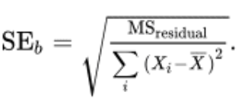
Standard Error of the Slope
Uncertainty is measured by the standard error, the standard deviation of the sampling distribution of b.
The smaller the standard error, the higher the precision and the lower the uncertainty of the estimate of the slope.
Notes:
This will help you with the formula on the last slide
This is the also the reason why I discussed ms residuals

Slide 31

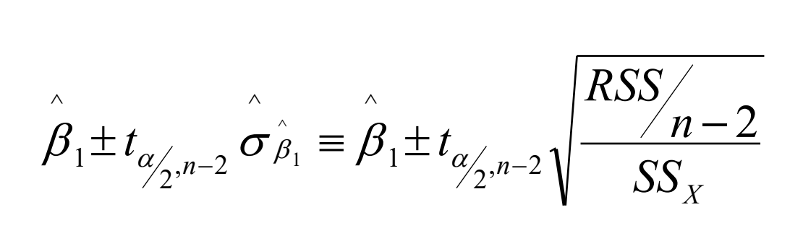
Confidence Interval for the Slope
Conclude positive association if entire interval above 0
Conclude negative association if entire interval below 0
Cannot conclude an association if interval contains 0
Conclusion based on interval is same as 2-sided hypothesis test
Notes:
These two formulas are the same thing!! You can flip through the slides and write it out yourself if needed
N-2 DF
This is a modest range of most-plausible values for the slope. The mean age of lions increases by as little as 7.6 years per unit proportion of black on the nose, or by as much as 13.7 years.

Slide 32
Confidence Bands and Prediction Intervals
Two subtly different types of predictions can be made using the regression line.
The first predicts the mean Y for a given X.
The second type predicts a single Y for a given X.
Both types of predictions generate the same value for Y^ (y-hat). They differ in the precision of the predictions!
Notes:
What, for example, is the mean age of all male lions in the population whose noses are 60% black
how old is that lion over there, given that 60% of its nose is black?)

Slide 33

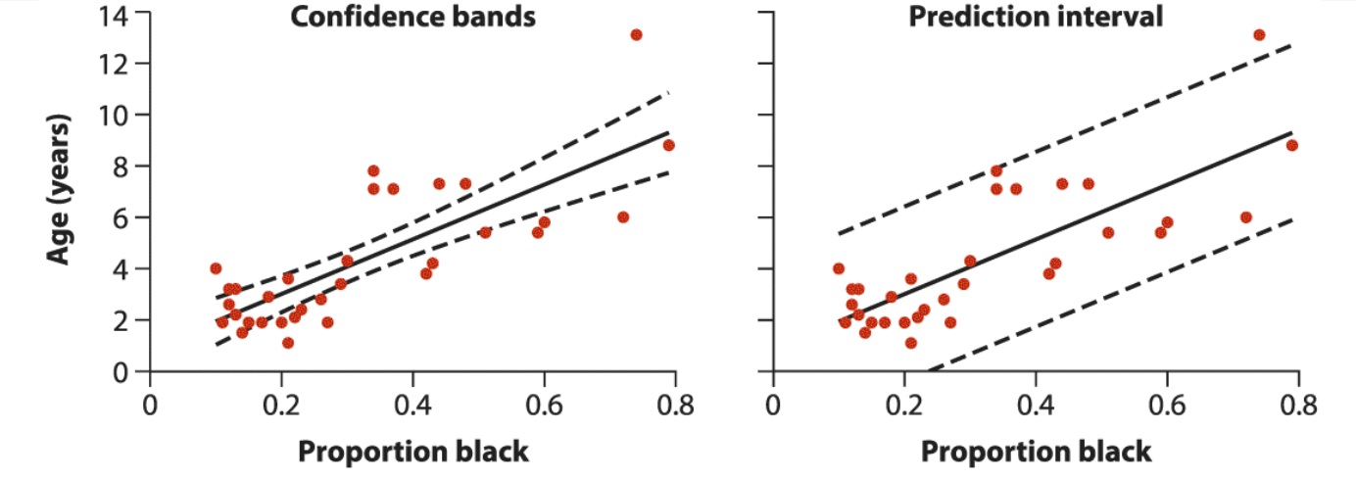
Notes:
Left shows the 95% confidence intervals for the predicted mean lion age at every X. The upper curve connects the upper bounds of all of the 95% confidence intervals for the predicted mean Y-values , one for every X between the smallest and largest X in the data. The lower curve connects the lower bounds of these same confidence intervals. Together the upper and lower curves showing the confidence intervals for the mean Y are called the 95% confidence bands. The uncertainty of predictions always increases the farther the X-value is from the mean X in the data. In 95% of samples, the confidence bands will bracket the true regression line in the population.
Right, the upper and lower curves connect the upper and lower limits of the 95% prediction intervals for a single Y over the range of X-values in the data. These are much wider than the confidence bands because predicting an individual lion’s age from the color of its nose is more uncertain than predicting the mean age of all lions having the same proportion of black on their noses. Prediction intervals bracket most of the individual data points in the sample, because they incorporate the variability in Y from individual to individual at a given X.

Slide 34
Extrapolation
Regression can be used to predict Y for any value of X lying between the smallest and largest values of X in the data set.
Regression cannot be used to predict the value of the response variable when an X-value lies well outside the range of the data.
This is because there is no way to ensure that the relationship between X and Y continues to be linear beyond the range of the data.
Predicting Y for X-values beyond the range of the data is called extrapolation.

Slide 35
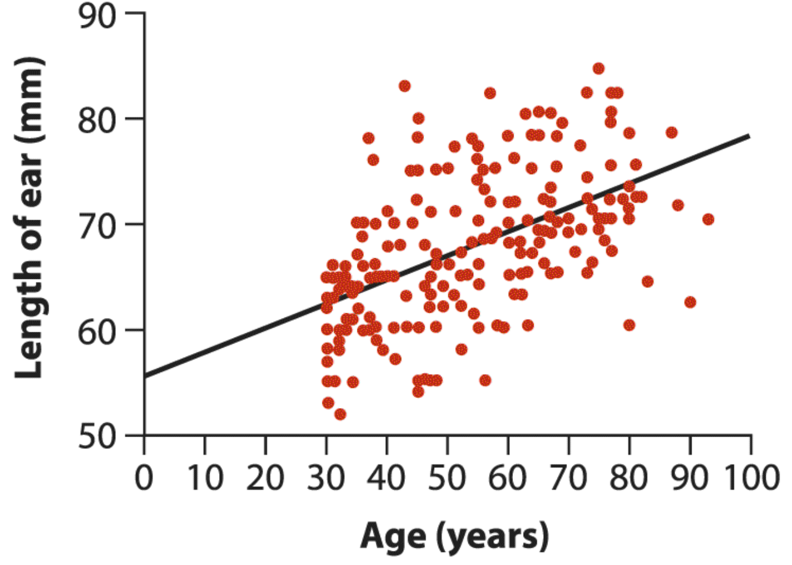
Extrapolation
Researchers measured the lengths of people’s ears from age 30 to 100.
They found that ears grow longer by about 0.22 mm per year on average as we age.
The intercept predicts ear length at birth, however…
Notes:
The intercept of this equation, which predicts the ear length at birth (i.e., when age is zero), is 56 mm. This makes no sense, though. To quote the authors of the study (Altman and Bland 1998), “A baby with ears 5.6 cm long would look like Dumbo.” The relationship between ear length and age is not linear from birth, but we wouldn’t know this unless we took measurements over the complete range of ages.
Danger! You want to only predict things within the range of your data. Outside of that, things could get wonky!

Slide 36




Try it Yourself!
Use JASP to test out a simple regression on light availability and sapling height!
This will be due Thursday, Oct. 1 at 11:59 PM.

